Slide 1
File Handling in C++ OOP
Beenish Urooj

Slide 2
Files (Streams)
Files are used to store data in a relatively permanent form, on floppy disk, hard disk, tape or other form of secondary storage. Files can hold huge amounts of data if need be.
Ordinary variables (even records and arrays) are kept in main memory which is temporary and rather limited in size. The following is a comparison of the two types of storage.

Slide 3
Type of Storage
Main memory
Made up of RAM chips.
Used to hold a program when it is running, including the values of its variables (whether integer, char, an array, etc.)
Can only hold relatively small amounts of data.
Is temporary (as soon as the program is done, or the power goes out all these values are gone).
Gives fast access to the data (all electronic).
Secondary memory
Usually a disk drive (or magnetic tape).
Used to hold files (where a file can contain data, a program, text, etc.)
Can hold rather large amounts of data.
Is permanent. (A file remains even if the power goes out. It will last until you erase it, as long as the disk isn't damaged, at least.)
Access to the data is considerably slower (due to moving parts).

Slide 4
Data File Handling In C++
File: The information / data stored under a specific name on a storage device, is called a file.
Stream: It refers to a sequence of bytes.
Text file: It is a file that stores information in ASCII characters. In text files, each line of text is terminated with a special character known as EOL (End of Line) character or delimiter character. When this EOL character is read or written, certain internal translations take place.
Binary file: It is a file that contains information in the same format as it is held in memory. In binary files, no delimiters are used for a line and no translations occur here.

Slide 5
C++ Streams
A Stream is a general name given to flow of data.
Different streams are used to represent different kinds of data flow.
Each stream is associated with a particular class, which contains member functions and definitions for dealing with that kind of data flow.

Slide 6
File Handling in C++
File Handling concept in C++ language is used for store a data permanently in computer. Using file handling we can store our data in Secondary memory (Hard disk).
Why use File Handling
Memory is volatile
Any data that you key in by keyboard while a program is running is also volatile
For permanent storage.
The transfer of input - data or output - data from one computer to another can be easily done by using files.

Slide 7
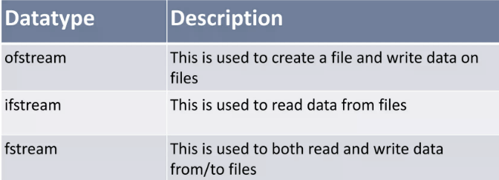
Header File for File Handling
So far, we have been using the iostream standard library, which provides cin and cout methods for reading from standard input and writing to standard output respectively.
This tutorial will teach you how to read and write from a file. This requires another standard C++ library called fstream, which defines three new data types:

Slide 8
Header File for File Handling
Input File Stream #include<ifstream>
Output file stream #include<ofstream>
Both (Input & Output) #include<fstream>

Slide 9
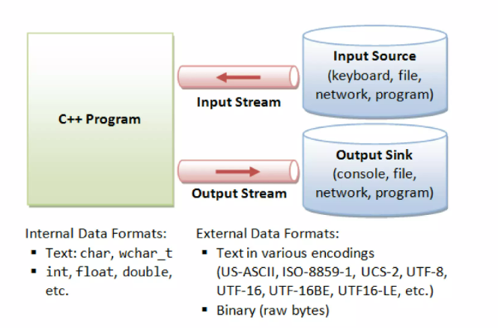
File Handling in C++

Slide 10
How to Achieve File Handling
Create a Handler Object
Naming a file
Opening a file
Reading data from file
Writing data into file
Closing a file

Slide 11
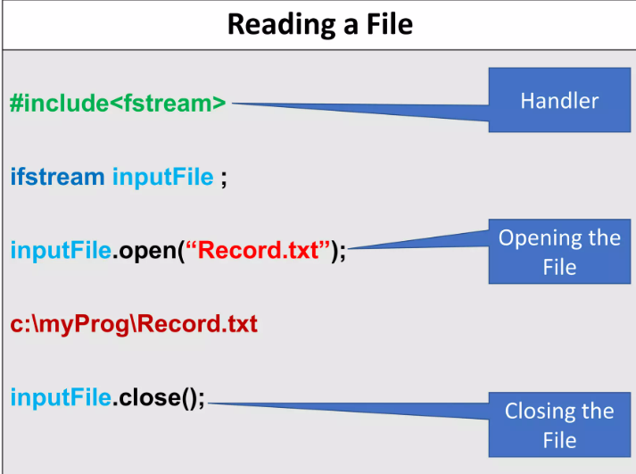

Slide 12
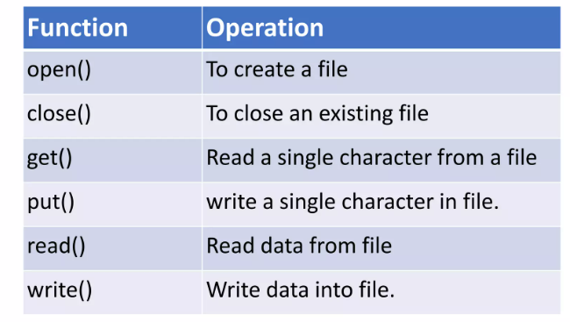
Functions use in File Handling

Slide 13
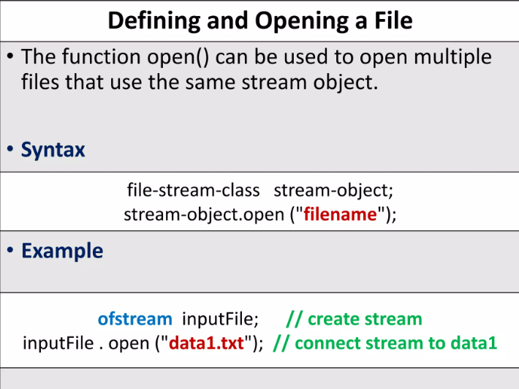

Slide 14
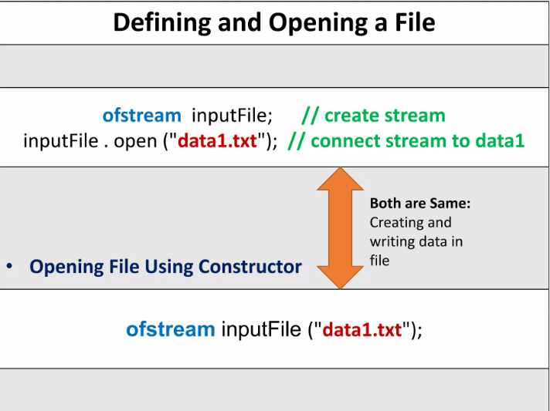

Slide 15
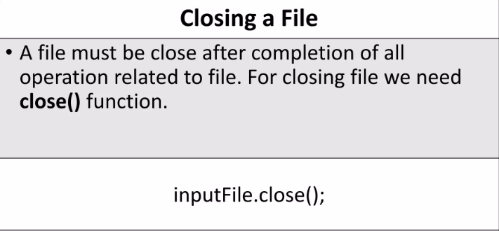

Slide 16
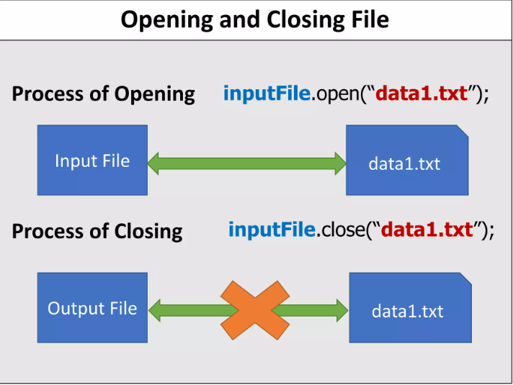

Slide 17
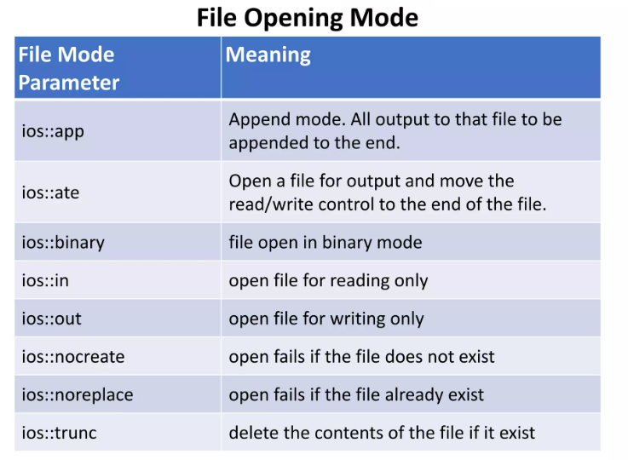

Slide 18
File Opening Mode
The default value for fstream mode parameter is in | out. It means that file is opened for reading and writing when you use fstream class.
When you use ofstream class, default value for mode is out and the default value for ifstream class is in.

Slide 19
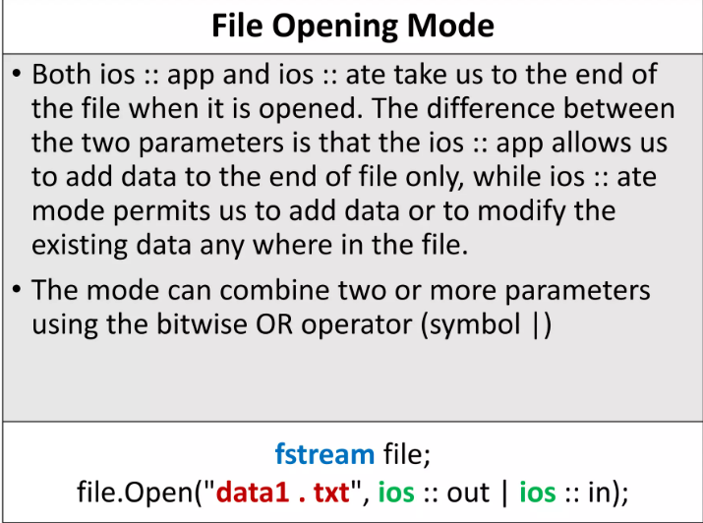

Slide 20
File Handling in C++
We can read data from file and write data to file in three ways.
Reading or writing characters using get() and put() member functions.
Reading or writing formatted I/O using insertion operator (<<) and extraction operator ( >> ).
Reading or writing object using read() and write() member functions.

Slide 21
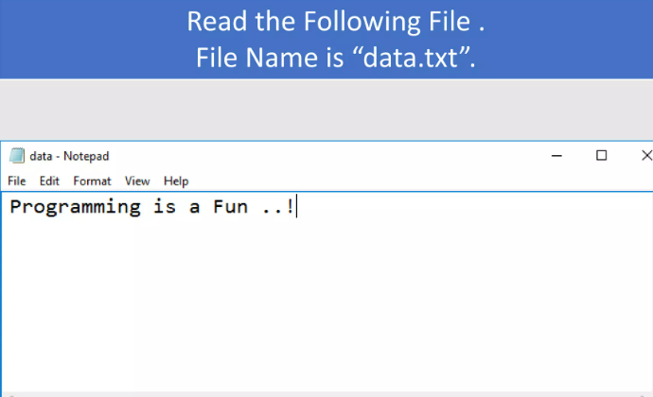
Example

Slide 22
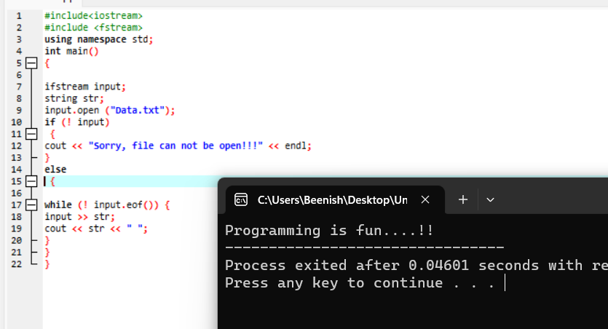
This creates an object of ifstream class named input to read data from a file.
This creates a string variable named str to hold the data read from the file.
If the file was successfully opened, this code block reads the file line by line until the end of file (eof()) is reached. It reads each word in a line and stores it in the str variable. Then it prints the word followed by a space. This loop continues until the end of the file is reached.

Slide 23
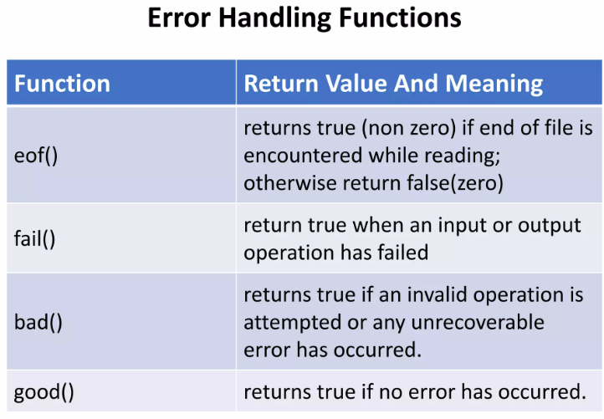

Slide 24
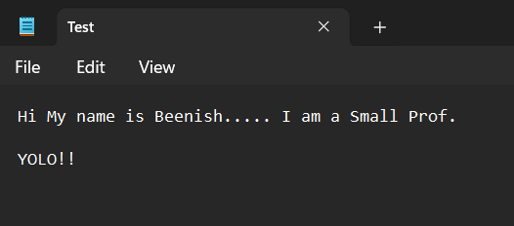
Example 2
Save this file as Test

Slide 25
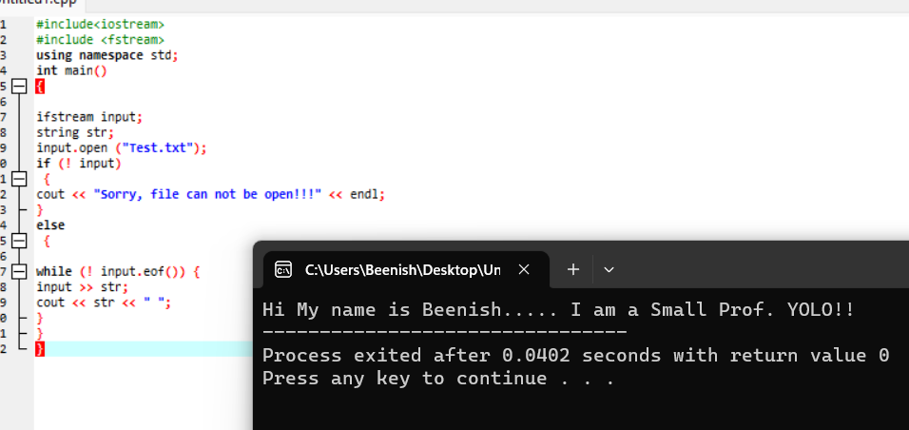

Slide 26
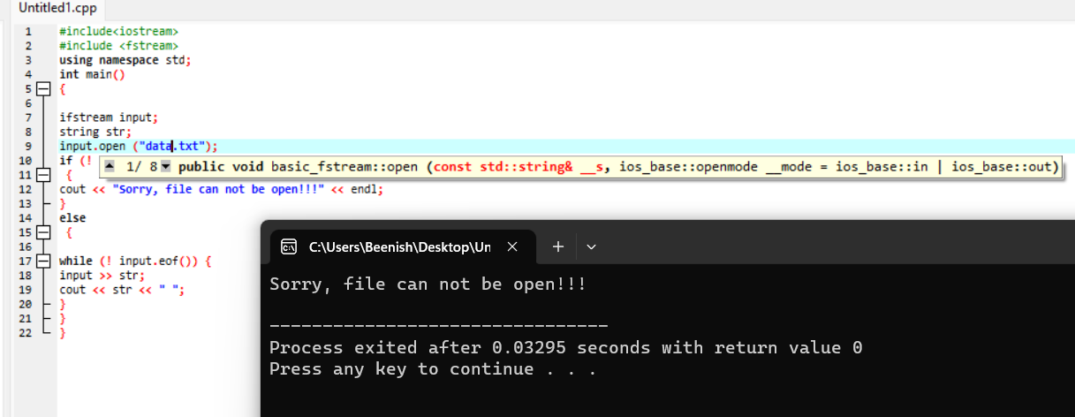

Slide 27
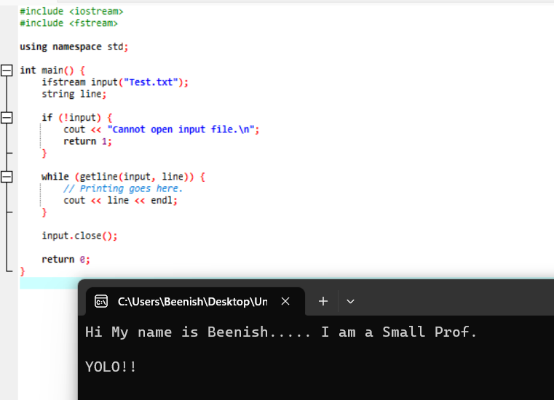
If the file was successfully opened, this code block reads the file line by line using the getline() function of the ifstream class. It reads each line in the file and stores it in the line variable. Then it prints the line to the console followed by a newline character. This loop continues until the end of the file is reached.

Slide 28
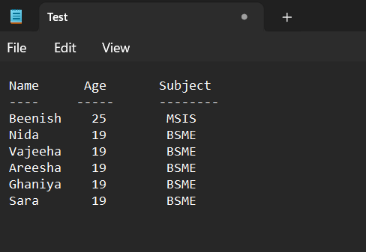

Slide 29
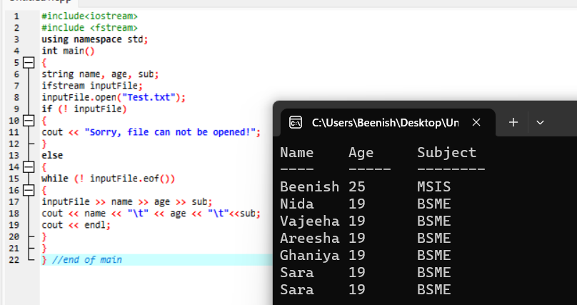
// read the next three whitespace-separated strings from the file into name, age, and sub

Slide 30
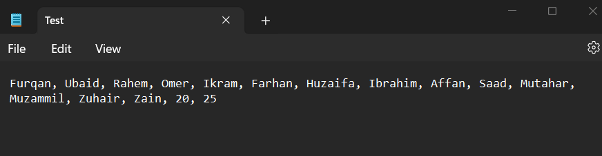

Slide 31
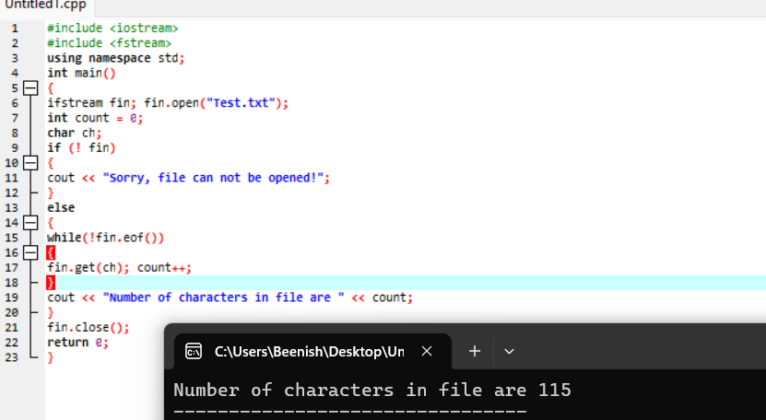

Slide 33
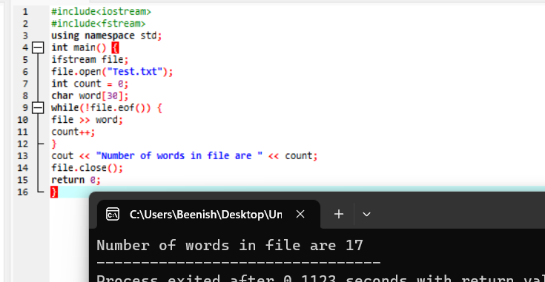

Slide 34
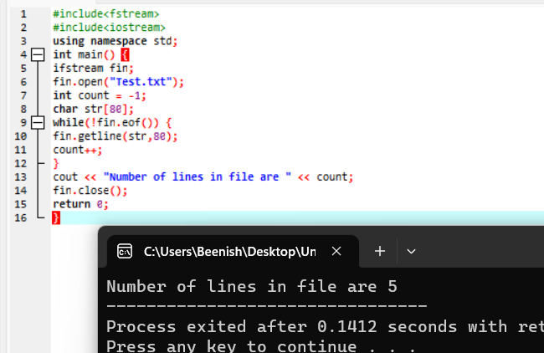

Slide 35
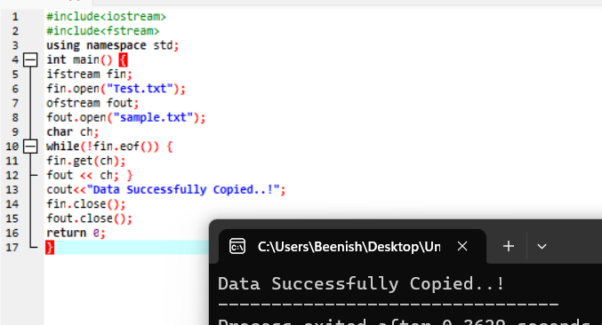

Slide 36
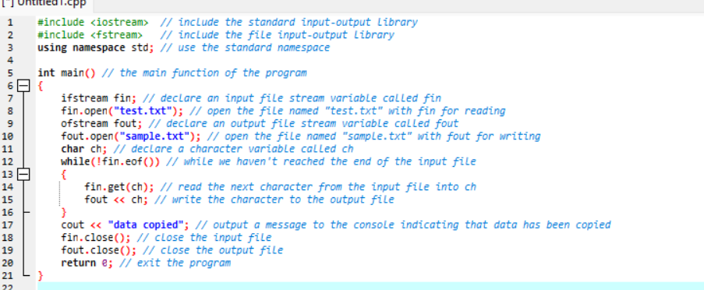

Slide 37

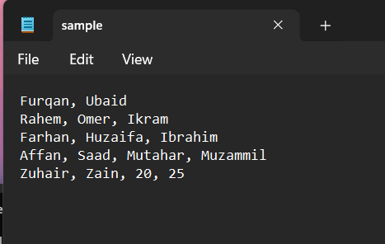

Slide 38
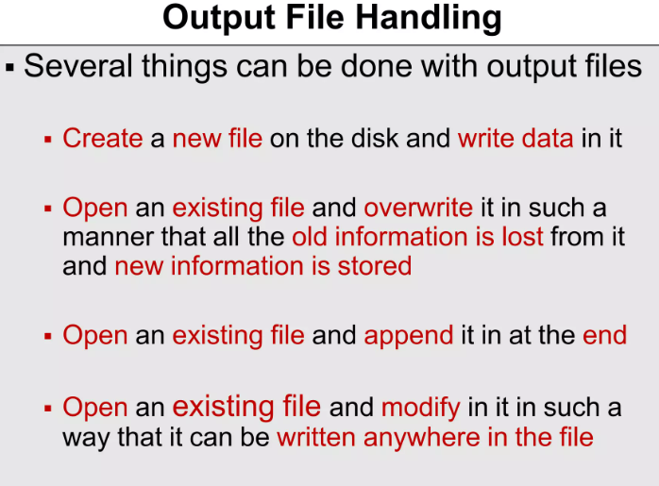

Slide 39
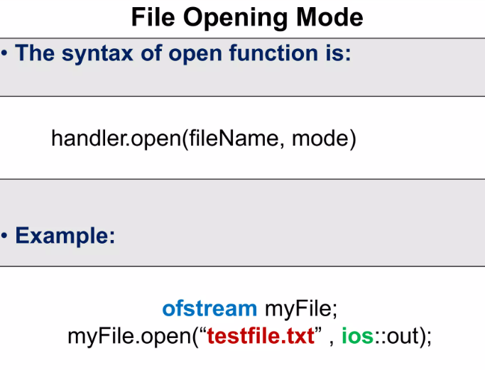

Slide 40

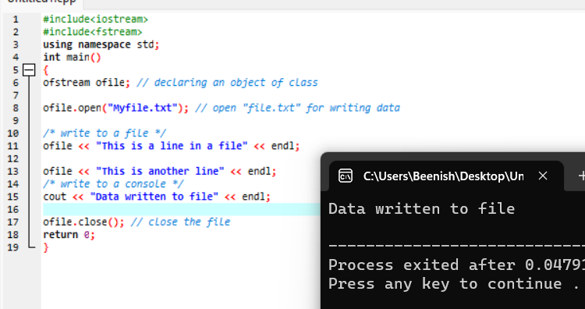

Slide 41
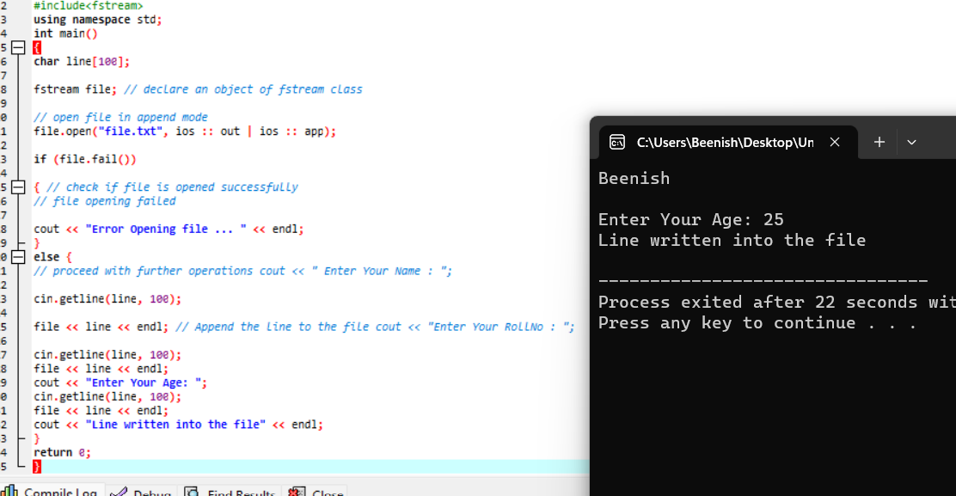

Slide 42
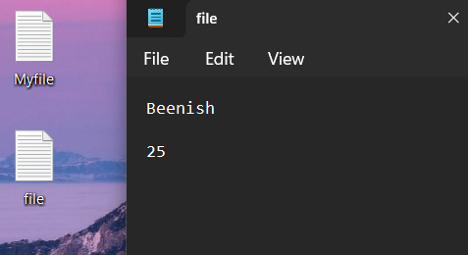

Slide 43
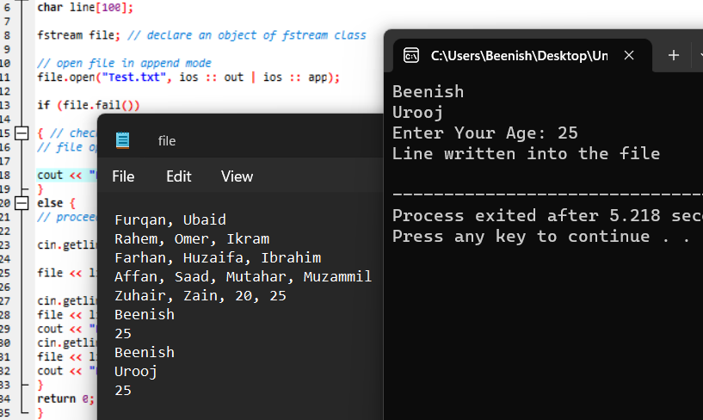

Slide 44
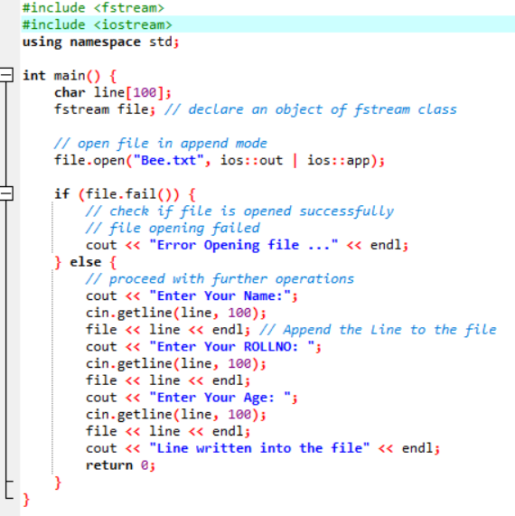
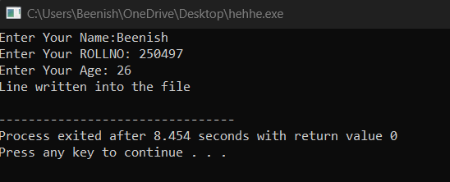
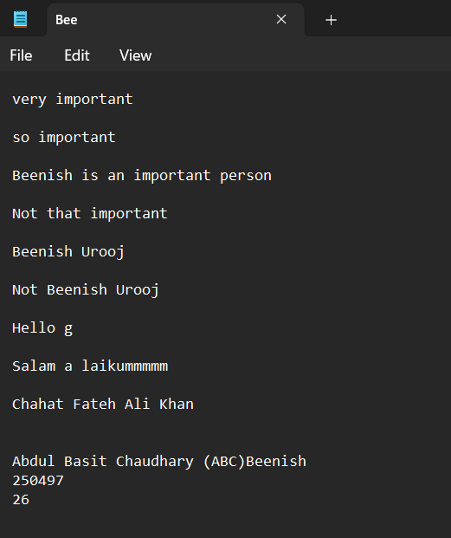

Slide 45
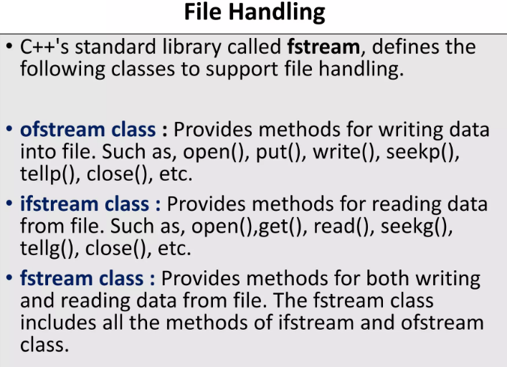

Slide 46
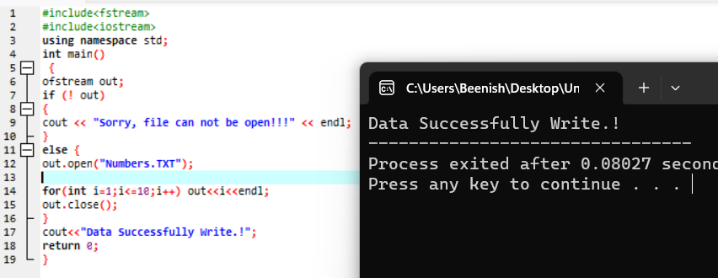

Slide 47
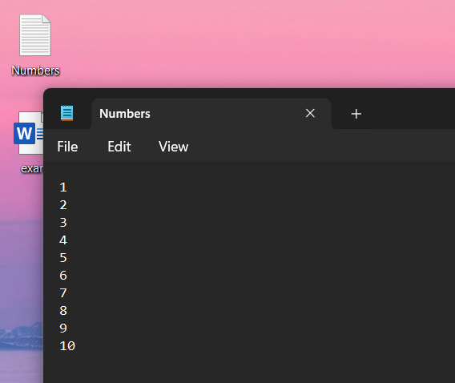

Slide 48
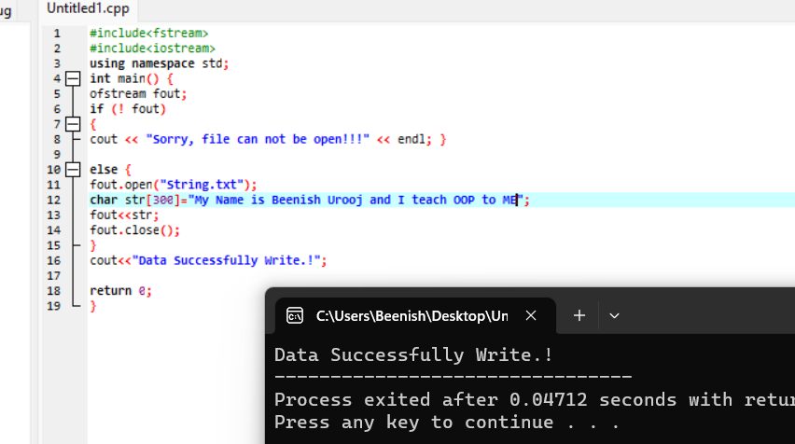

Slide 49
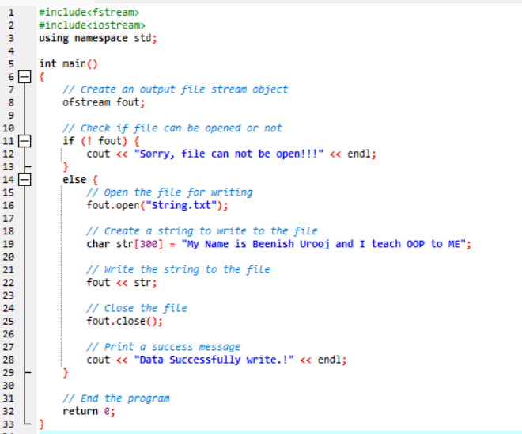

Slide 50
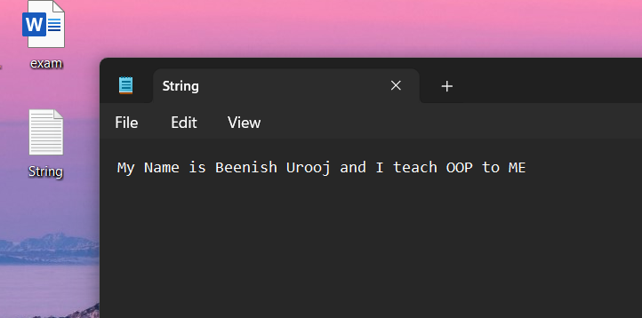

Slide 51
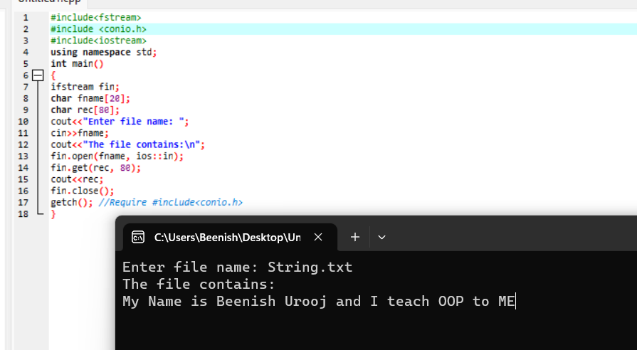
Retrieving Information from a file

Slide 52
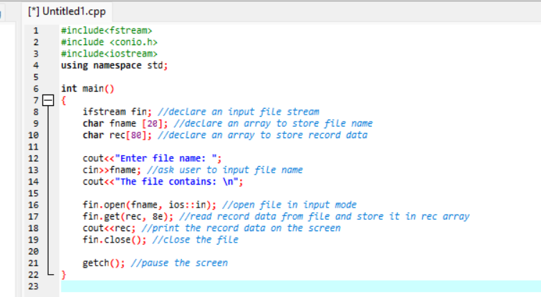
Retrieving Information from a file

Slide 53
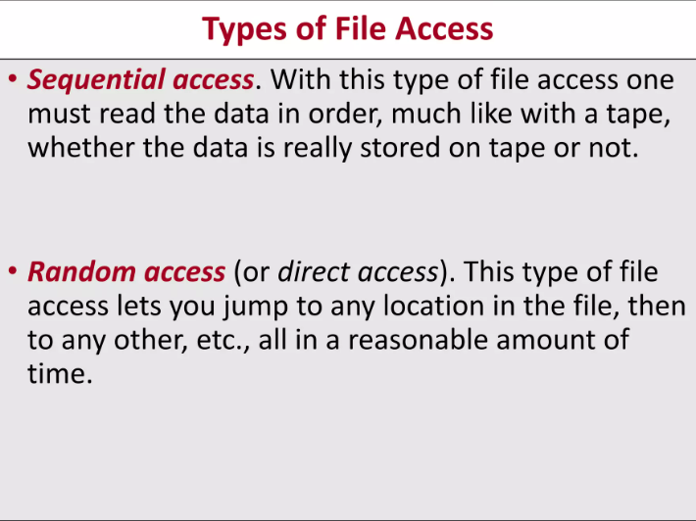

Slide 54
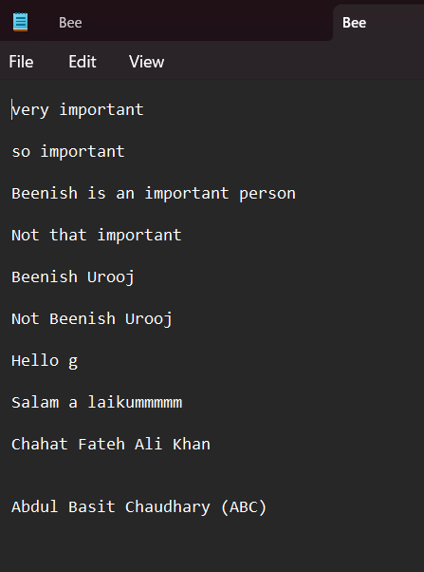
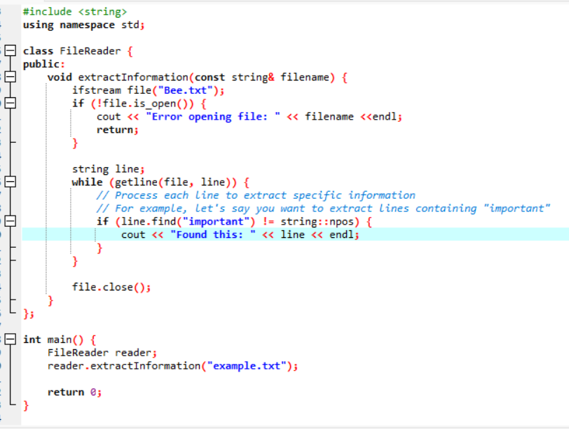

Slide 55
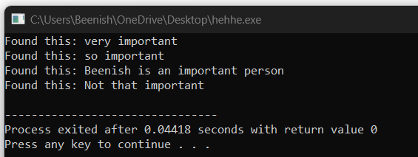

Slide 56
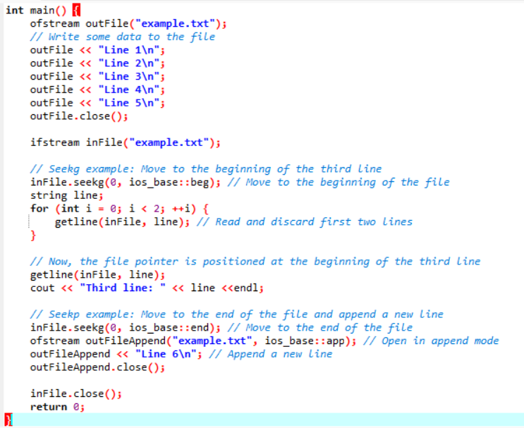
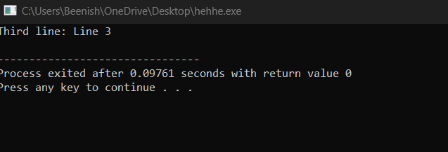
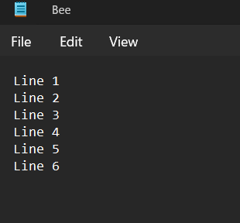
seekg is used to set the position of the file pointer for input operations.
seekp is used to set the position of the file pointer for output operations.

